Slide 1
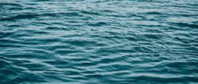
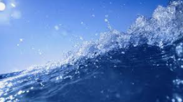
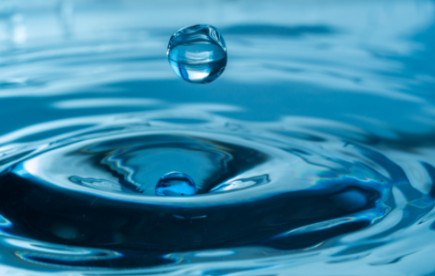
WATER
PREETI GAMBHIR

Slide 2

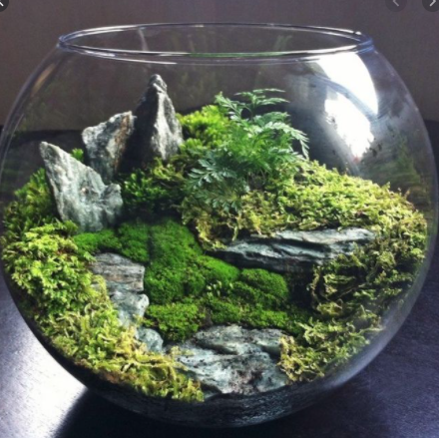
TERRARIUM
Terrarium is an artificial self irrigating enclosure for keeping small house plants that requires very less water.
Our earth is like a giant terrarium. The same water that existed centuries ago still exists today and travels through various water bodies across the world.
The water used to irrigate a field in Haryana may have flowed down the Amazon River a hundred years ago.

Slide 3
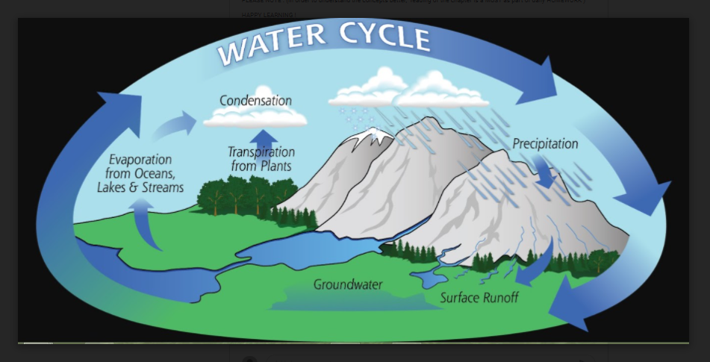
WATER CYCLE/ HYDROLOGICAL CYCLE
Water cycle –Hydrological Cycle is the process by which water continually changes its form and circulates between oceans, atmosphere and land. The process involves:-
Evaporation of water from various water bodies due to the heat of the sun .
Release of water vapour /droplets from plants is known as Transpiration.
Condensation is the process of water vapour turning back into liquid water and formation of clouds .
And when the water droplets in clouds combine, they become heavy enough to form raindrops to rain (Precipitation)
Surface runoff is water, from rain, snowmelt, or other sources, that flows over the land surface
Infiltration is the process by which water on the ground surface enters the soil.

Slide 4
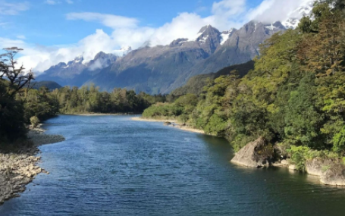
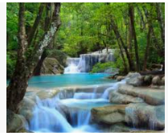
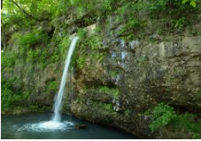
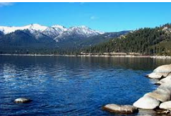
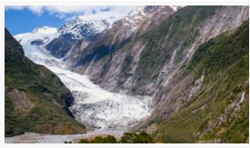
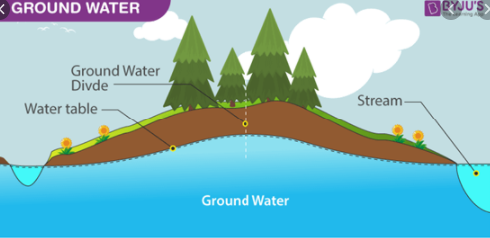
FRESH WATER SOURCES
The major sources of fresh water are
Rivers
springs
Glaciers
Fresh water Lakes
Groundwater

Slide 5
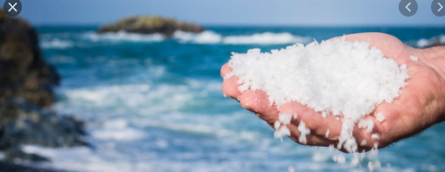
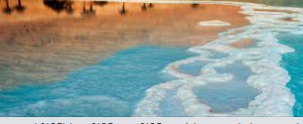
SALINITY OF WATER
The ocean bodies and the seas contain salty water. It is saline as it contains large amount of dissolved salts. Most of the salt is sodium chloride or the common table.
Salinity is the amount of salt in grams present in 1000 grams of water.
The average salinity of the oceans is 35 parts per thousand.

Slide 6
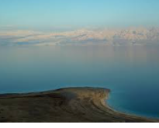
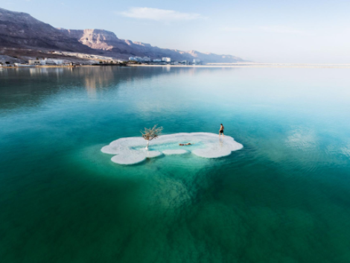
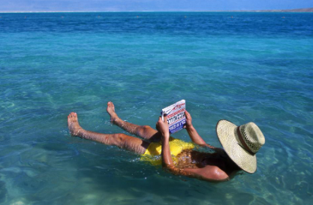
DEAD SEA
The Dead sea in Israel is a landlocked Salt lake bordered by Jordan to the east and Israel and the West Bank to the west.
The Dead Sea has the lowest elevation and is the lowest body of water on the surface of Earth also called Salt Sea
It has salinity of 340 grams per litre of water.
Swimmers can float in it because the increased salt content makes it dense

Slide 7
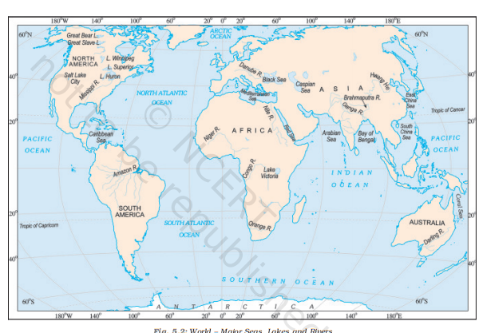
MAJOR WATER BODIES

Slide 8
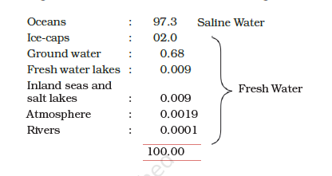
DISTRIBUTION OF WATER BODIES
Three-fourth of the earth surface is covered by water in the form of Oceans, seas, Ice caps, Ground water, fresh water lakes, salt lakes , rivers, streams and water vapour in the atmosphere but in different quantities .

Slide 9
FACTORS RESPONSIBLE FOR MOVEMENT OF WATER
Wind/storms
Pressure –High and Low
Temperature (of water /air above the water)
Rotation of Earth
Gravitational pull of Moon and Sun on Earth
Sudden movements inside oceans –earthquake and volcanic eruptions

Slide 10
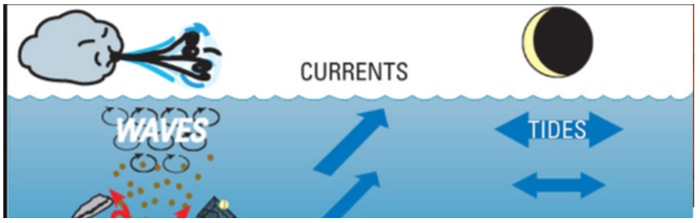
MOVEMENTs IN WATER
1. WAVES
2. TIDES
a. Spring Tides
b. Neap Tides
3.CURRENTS
a. Warm Currents
b. Cold Currents

Slide 11
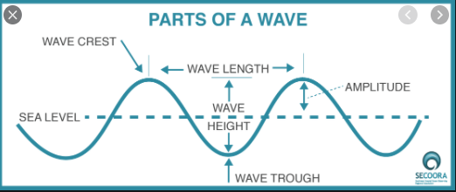
WAVES
When the water on the surface of the ocean rises and falls alternately, these are called waves.
Waves are formed when winds scrape across the ocean surface.
The stronger the wind blows, the bigger the wave becomes.
Parts of Wave are :-
CREST - the highest point of a wave
TROUGH- the lowest point of a wave
AMPLITUDE- the maximum displacement of a point of a wave from its rest position.
WAVE LENGTH- distance covered by a full cycle of the wave usually measured from peak to peak, or trough to trough
WAVE HEIGHT- the vertical distance between a Crest and Trough

Slide 12
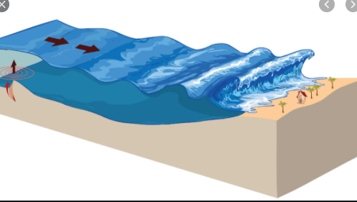
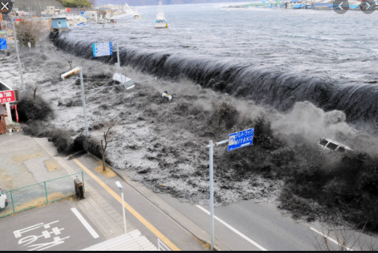
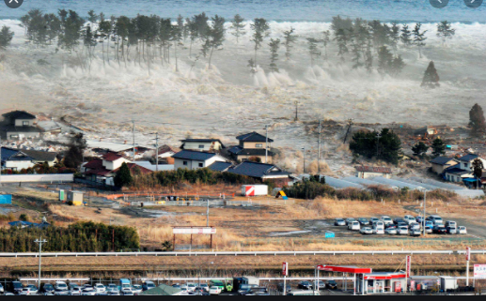
TSUNAMI
Tsunami is a Japanese term that means “Harbour waves” as the harbours/ ports get destroyed whenever there is tsunami
An earthquake, a volcanic eruption or underwater Landslides can shift/displace large amounts of ocean water towards the shore. As a result a huge tidal wave called tsunami, that may be as high as 15m, is formed that can cause large scale destruction to life and property .
These waves travel at a speed of more than 700 km. per hour.
The tsunami of 2004 caused wide spread damage in the coastal areas of India. The Indira point in the Andaman and Nicobar islands got submerged after the tsunami.

Slide 13
TIDES
TIDES- The rhythmic rise and fall of ocean water twice in a day due to the strong gravitational pull exerted by the sun and the moon on the earth’s surface is called a tide.
HIGH TIDE - It is high tide when water covers much of the shore by rising to its highest level.
LOW TIDE -It is low tide when water falls to its lowest level and recedes from the shore.
SPRING TIDES - The water of the earth closer to the moon gets pulled under the influence of the moon’s gravitational force and causes high tide. During the full moon and new moon days, the sun, the moon and the earth are in the same line and the tides are highest. These tides are called spring tides.
NEAP TIDES-But when the moon is in its first and last quarter, the ocean waters get drawn in diagonally opposite directions by the gravitational pull of sun and moon resulting in low tides. These tides are called neap tides.

Slide 14
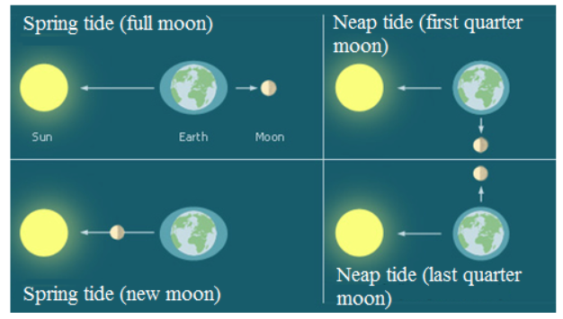
SPRING AND NEAP TIDES

Slide 15

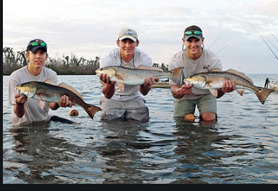
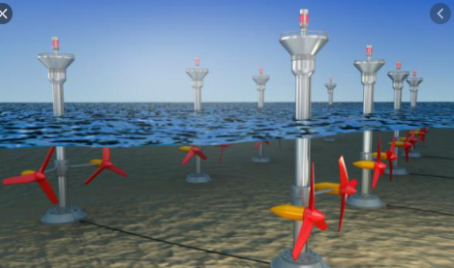
IMPORTANCE OF TIDES
NAVIGATION - High tides help in navigation. It raises the water level close to the shores which helps the ships to arrive at the harbour more easily and saves on fuel too.
FISHING -The high tides also help in fishing. More fishes come closer to the shore during the high tide. This enables fishermen to get a plentiful catch.
TIDAL ENERGY -The rise and fall of water due to tides is being used to generate electricity in some places .

Slide 16
OCEAN CURRENTS
Ocean currents are streams of water flowing constantly on the ocean surface in definite directions.
The ocean currents may be of two types –WARM CURRENTS or COLD CURRENTS
Generally, the warm ocean currents originate near the equator and move towards the poles. For eg. the Gulf Stream and Equatorial Currents are warm currents.
The cold currents carry water from polar or higher latitudes to tropical or lower latitudes. For eg. The Labrador and Peru current are cold current
FACTORS THAT EFFECT CURRENTS
Winds, water density, Salinity and tides- effect the ocean currents.
Coastal and sea floor features influence their location, direction, and speed.
Earth's rotation results in the Coriolis effect which also influences ocean currents to move in a particular diretion (that is clockwise in the Northern Hemisphere and Anti Clockwise in the southern hemisphere)

Slide 17
SIGNIFICANCE of OCEAN CURRENTS
The ocean current influence the temperature conditions of the area. Warm currents bring about warm temperature over land surface.
The areas where the warm and cold currents meet provide the best fishing grounds of the world. For eg. Seas around Japan and the eastern coast of North America
The areas where a warm and cold current meet also experience foggy weather making it difficult for navigation and there it becomes reason for ship wrecks

Slide 18
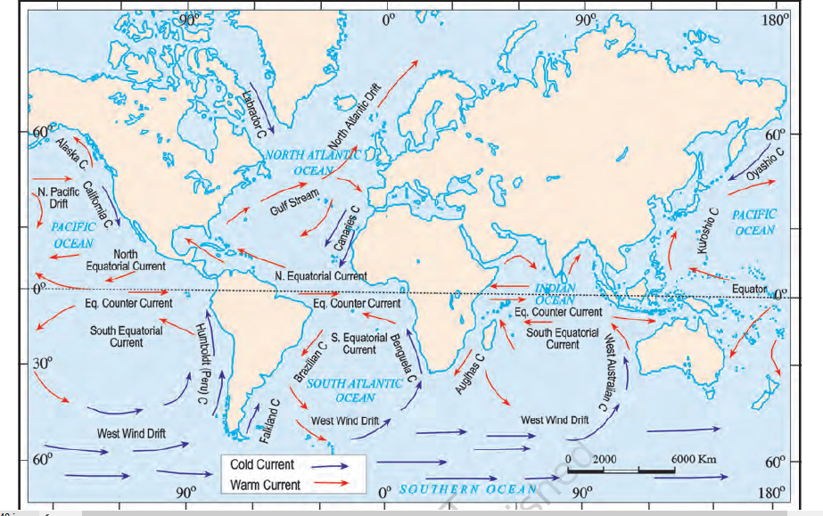

Slide 19
THANK YOU !
Preeti Gambhir

